Slide 1

ROOMIE RADAR - Smart Roommate Finder Portal
by
K.NIVEDITHA
Roll No. 224G1A0563
P.AJAY KUMAR
Roll No. 224G1A0502
A.S. SABIHA AFRIN
Roll No. 224G1A0588
Under the guidance of
Mrs. S. Sunitha , M.Tech .,Ph.D.
Assistant Professor
Department of Computer Science and Engineering
Srinivasa Ramanujan Institute of Technology
Autonomous
Rotarypuram Village, B K Samudram Mandal, Ananthapuramu – 515701.
2025-2026

Slide 2

Contents
Title Justification
Abstract
Problem statement
Objectives of Project
Literature survey for objectives
Proposed Work -(Methods to be followed for proposed system)
References
GitHub Link
Queries

Slide 3
Title Justification
Roomie Radar: Smart Roommate Finder Portal
The title “Roomie Radar – Smart Roommate Finder Portal” is selected to represent the system’s core objective of simplifying shared accommodation management. The word “Roomie” reflects its focus on identifying compatible roommates, while “Radar” symbolizes intelligent searching and detection. This combination conveys a platform that uses matchmaking and location-based search to recommend the best living options.
The title also highlights that the system goes beyond basic hostel listings by integrating online booking, secure payments, digital rental contracts, and real-time communication. It is concise, meaningful, and clearly represents a smart, technology-driven platform designed to streamline the entire accommodation process. Thus, the title effectively reflects the system’s purpose, coverage, and the advanced features it offers.

Slide 4
Abstract
Shared accommodation is widely used, but current PG/hostel systems are fragmented and unreliable.
Users face issues like unverified information, manual searching, and no combined platform.
The research aims to develop a unified system with roommate matching, PG/hostel search, secure booking, digital contracts, and chat.
The system collects user preferences, calculates compatibility scores, and integrates booking and contract features.
Results show improved matching accuracy, more trustworthy hostel choices, and a smoother booking experience.
The research concludes that the integrated platform optimizes the shared accommodation process by improving system reliability, enhancing data-driven roommate matching, and streamlining end-to-end room booking operations.

Slide 5
Problem Statement
Finding PG/hostel rooms and suitable roommates is still manual and unorganized
Users depend on scattered platforms and unverified information, leading to mismatches and trust issues.
There is no system that provides Score based roommate matching using user preferences.
Hostel /PG search, booking, payments, and communication are not available in a single platform.
Digital rental contracts and secure online payment options are missing.
Lack of real-time communication causes delays and mismanagement between users and hostel owners.
A unified, intelligent, and secure platform is needed to solve these issues effectively.

Slide 6
Objectives of Project
1.To build a secure, authenticated roommate matching system that uniquely uses a score-based compatibility algorithm combining lifestyle habits, budget, personal preferences, and location radius to deliver personalized and highly accurate roommate recommendations not possible through manual or profile-only matching methods.
2. To develop a unified and authenticated PG/hostel booking platform that integrates location-based hostel discovery, room booking, secure online payments, digital contract generation, and real-time communication into one end-to-end system replacing the need for multiple separate apps and offering a seamless, complete accommodation workflow.

Slide 7
Literature survey for objectives
Literature survey for objectives
Literature survey for objectives
No | Title | Authors | Journal Name & Year | Methodology Adapted | Key Findings | Gaps
1. | Roommate Allocation System Based on preference matching. | S. Kumbhar, M. Rasal, S. Kurle, A. Kasulkar, S. P. Gunjal | International Journal of Innovative Research in Technology (IJIRT), Vol. 11, No. 6, 2024 | Preferences are collected, weighted, scored, and ranked with location filtering. | Score-based preference matching improves roommate compatibility by comparing lifestyle, budget, and personal preferences. | Existing systems rely on manual or profile-only matching and do not use a secure, authenticated, multi-factor score-based method for accurate roommate compatibility.
2. | Unified PG/Hostel Booking and Management Platform for Improved User Experience | H. Ping | Proceedings of ISCCCA (International Symposium on Computer, Communication, Control and Automation), 2013 | Built a centralized web-based reservation system using modular design and database-driven booking | Online reservation systems significantly enhance booking efficiency, reduce manual workload, minimize human error, and improve overall user accessibility to accommodation services. | Existing PG/hostel systems are fragmented, lacking secure authentication, unified booking, digital contracts, and real-time communication in one end-to-end platform.

Slide 8
Proposed System
A unified platform that integrates PG/hostel search, booking, and roommate matching.
Preference-based scoring system to recommend the most compatible roommates.
Secure online payment system for seamless room booking.
Digital rental contract generation for safer and transparent agreements.
Role-based access for Users, Hostel Owners, and Admins to manage their respective functions.
Real-time chat system for smooth communication between users and hostel owners.

Slide 9
References
[1]. S. Kumbhar, M. Rasal, S. Kurle, A. Kasulkar, and S. P. Gunjal, “Roommate Allocation System with AI Integration,” International Journal of Innovative Research in Technology (IJIRT), vol. 11, no. 6, pp. 1479–1481, Nov. 2024.
[2]. H. Ping, “Development and Implementation of Web-Based Online Hotel Reservation System,” Proceedings of the 2nd International Symposium on Computer, Communication, Control and Automation (ISCCCA-13), Hefei University, Anhui, China, 2013.

Slide 10
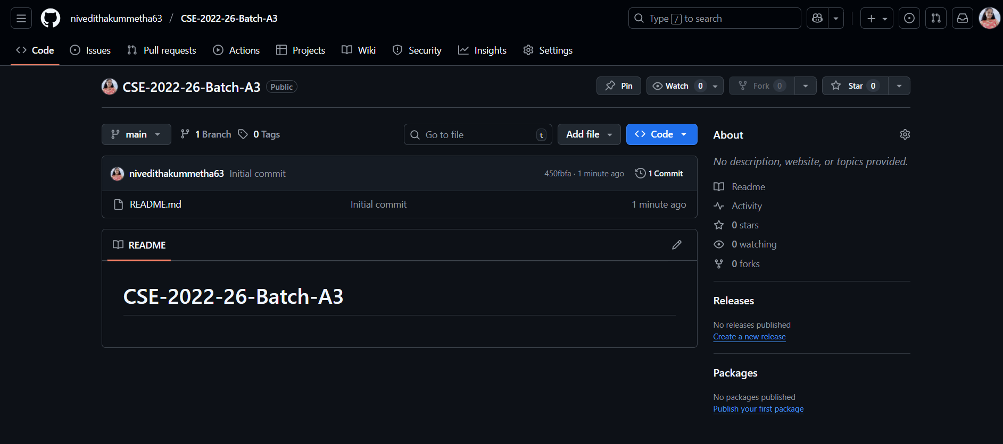
Git Hub Dashboards of each student
link of the Github: https://github.com/nivedithakummetha63/CSE-2022-26-Batch-A3

Slide 11
Any Queries?

